Slide 1

Artificial Intelligence
Anurag Srivastava

Slide 2
Agenda
The need of AI
Examples of AI based systems / products
What the world has already accomplished in AI
Fundamental Logic behind AI
Simple Example of AI (Exercise)
Sneak Peak into an AI Brain
Key Ingredients of AI
Steps involved in any AI Project
Few AI Applications that we have built
AI Use cases (E-commerce, Financial Services & Software Development)
Let’s meet M.E.L.I.S.A.
Conclusion – What is AI?

Slide 3
Pre-requisites of the course
1. You should be able to understand logic and common sense.
2. No programming knowledge Required
3. No Technical Background Required

Slide 4

Know your trainer
14+ years of work experience in Analytics, Machine Learning (ML) and Artificial Intelligence (AI).
On board trainer for LHL, Oracle, Edureka, InnoServ, SkillSir etc.
Delivered multiple projects for multiple clients in India, Egypt, USA, Australia, Singapore and Kuwait.
Delivered multiple training sessions on Predictive & Prescriptive Analytics, ML & AI.
Successfully created M.E.L.I.S.A. for a leading healthcare company in USA.
Successfully created a NLP engine for an investment advisor company in Australia.
Successfully created automated speech engines, image recognition programs, object recognition in live video feeds and chatbots.

Slide 5
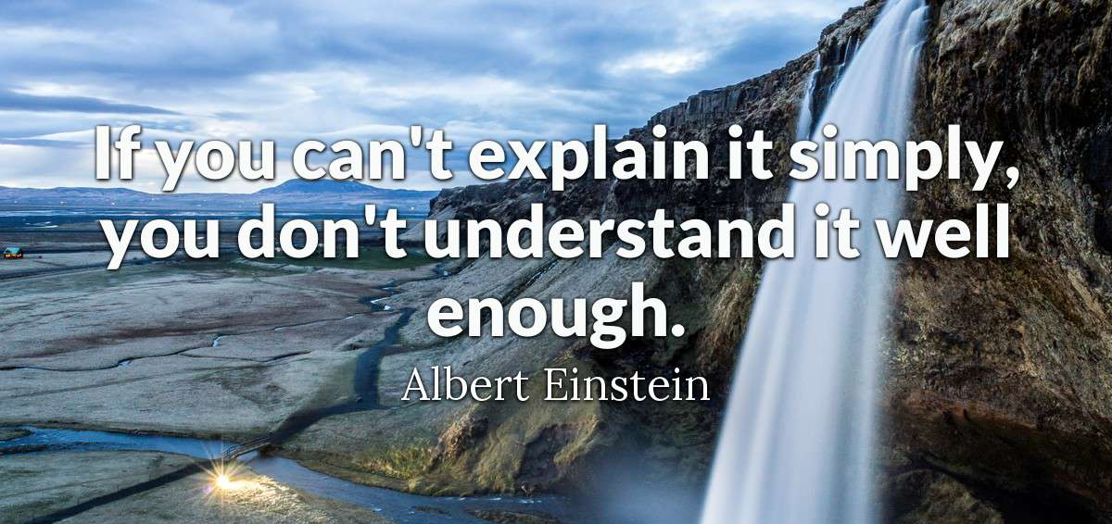

Slide 6
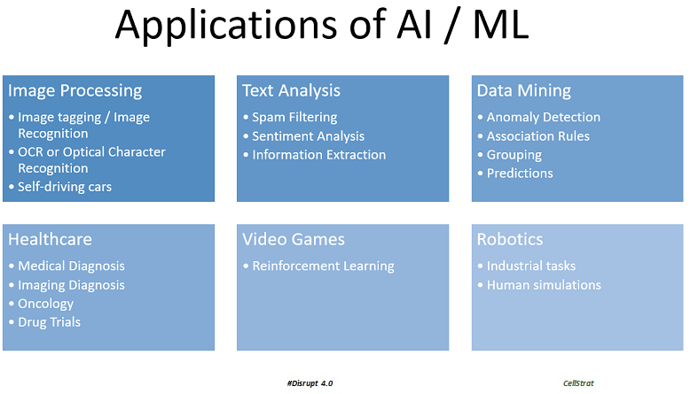
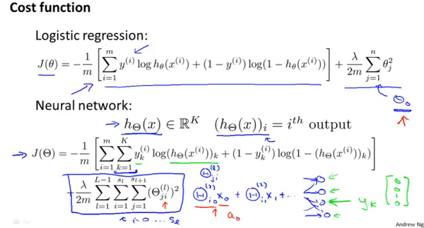
Approach to the course
✓
✗

Slide 7
The Progression
MIS
Predictive Analytics
Prescriptive Analytics
Data Mining
Data Analytics
Machine Learning
BI
Artificial Intelligence
Data Science

Slide 8
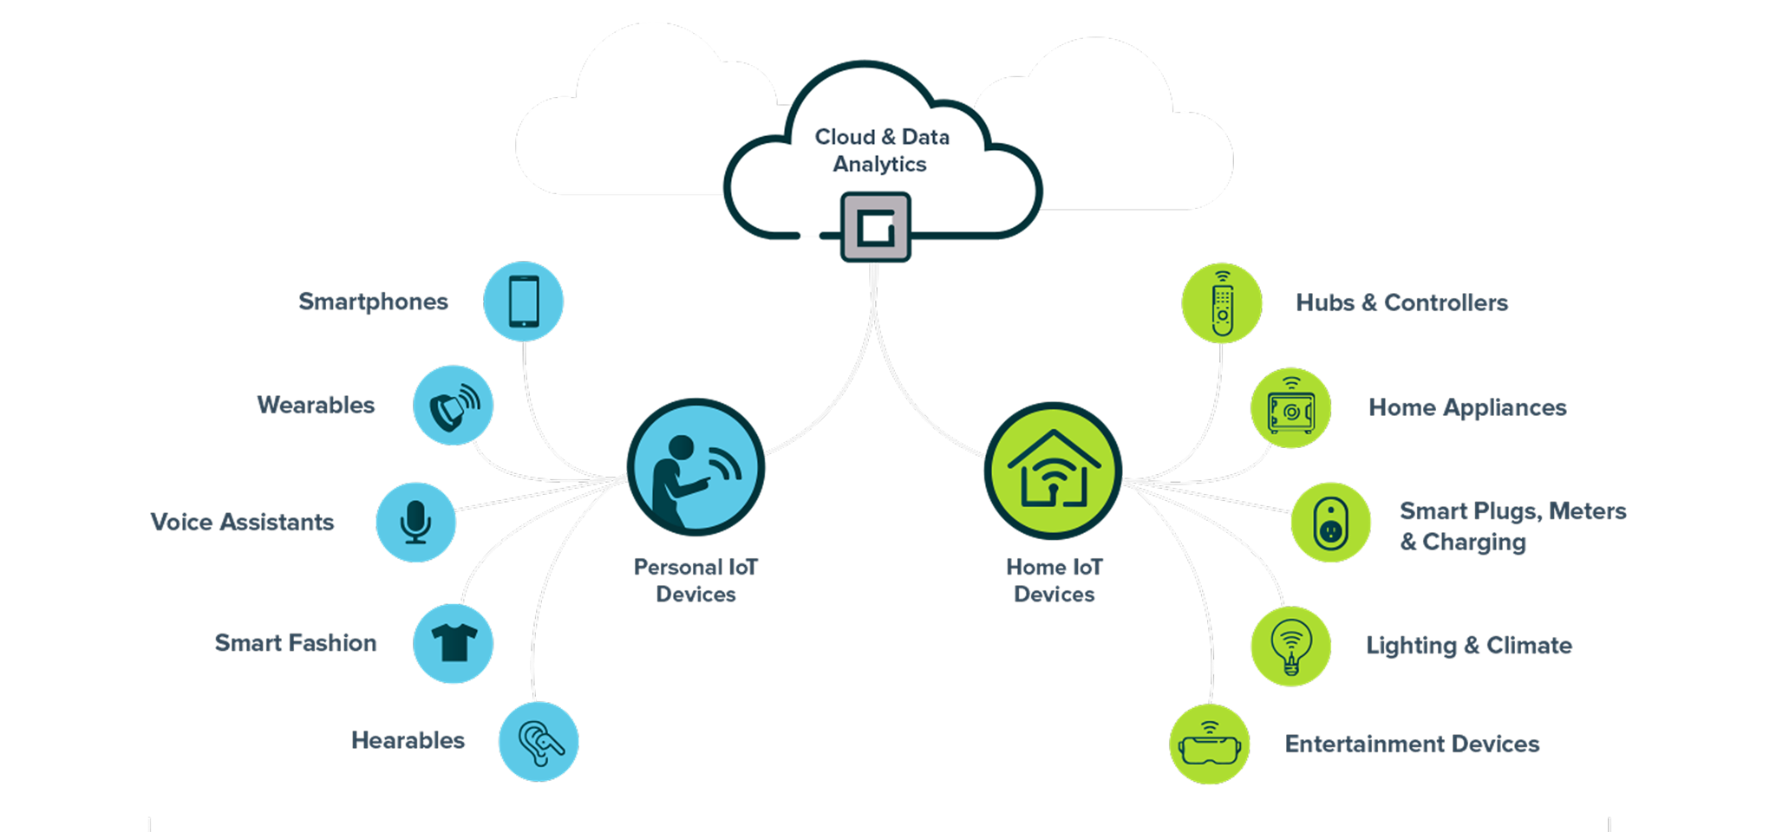
The New Buzz

Slide 9
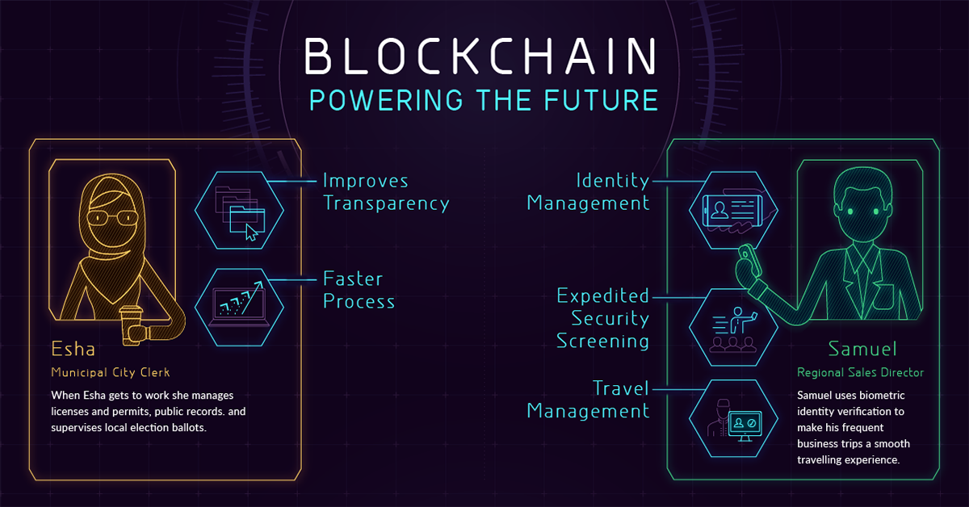
The New Buzz

Slide 10

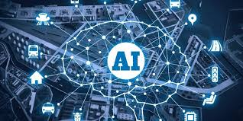
The Core of Everything!

Slide 11
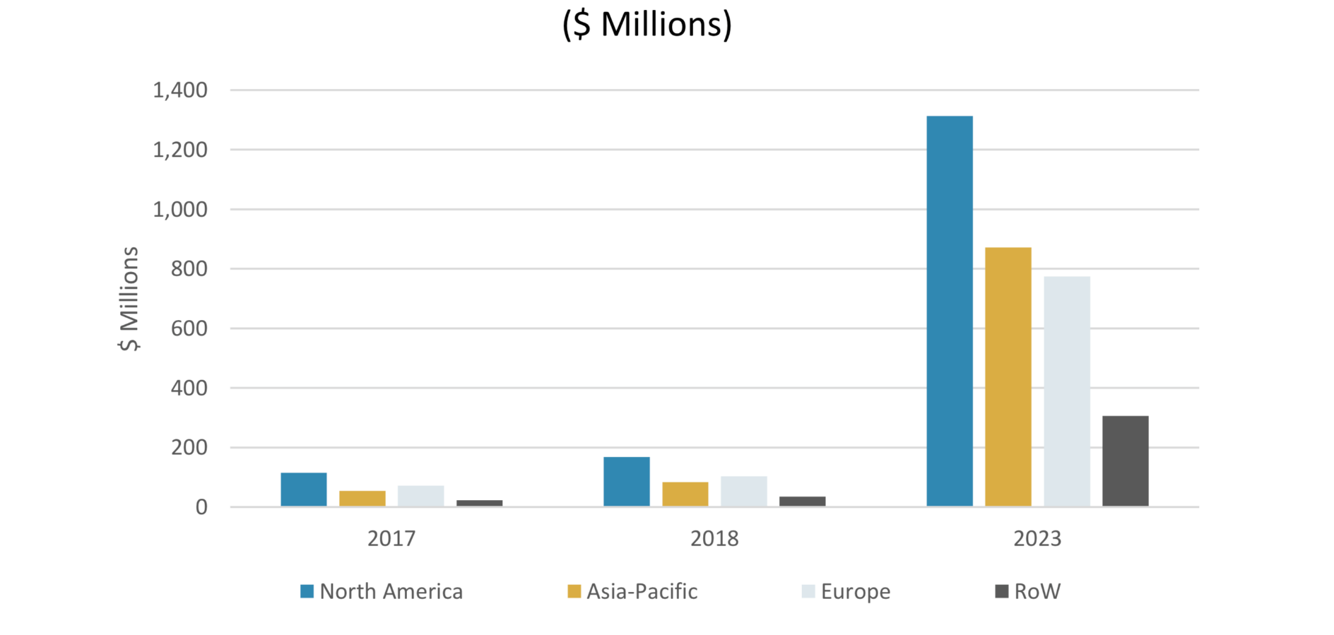
Growth in AI

Slide 12
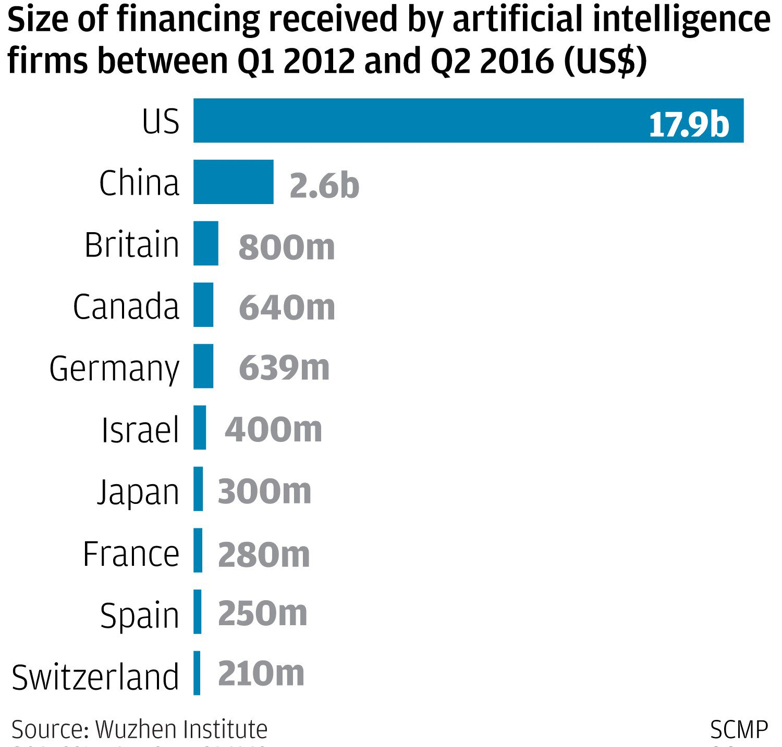
Investment in AI (Countries)

Slide 13
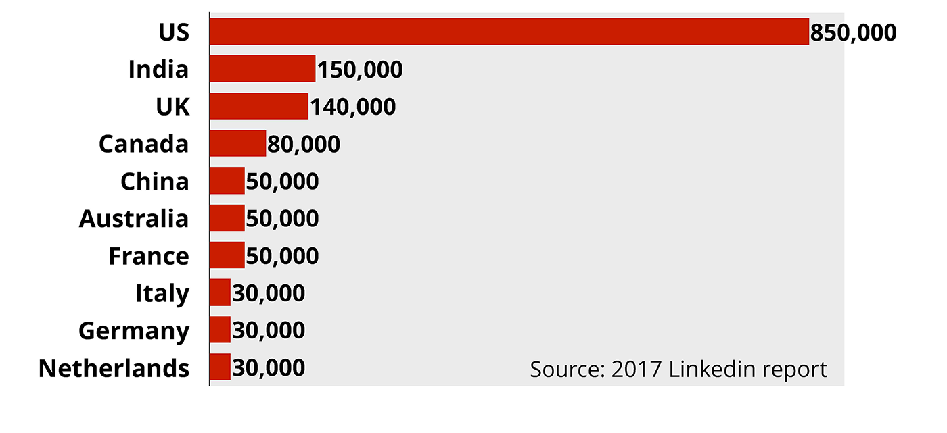
Talent in AI (Countries)

Slide 14
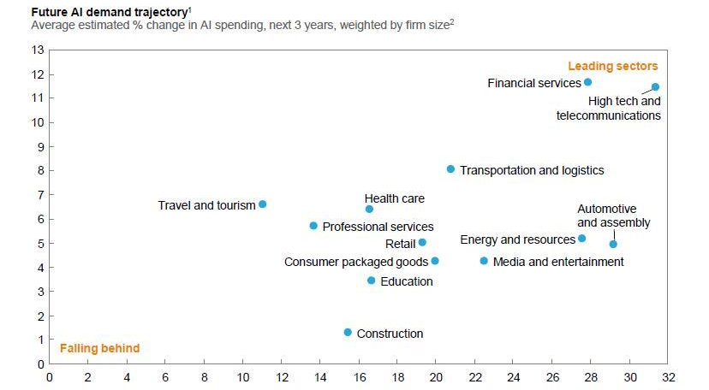
Investment in AI (Industries)

Slide 15
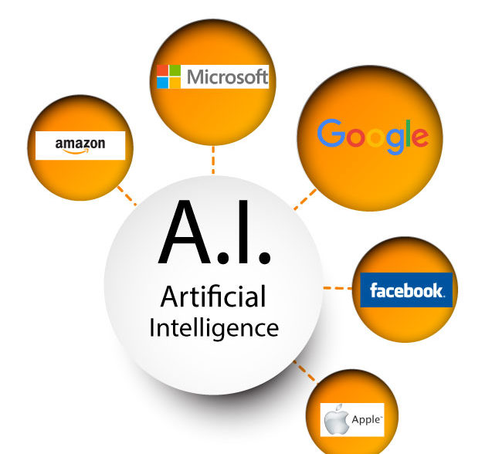
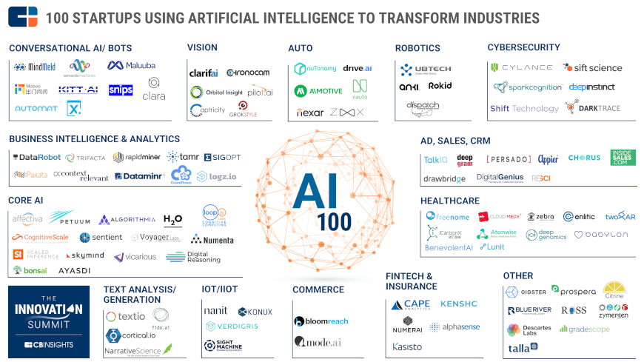
Companies hiring for AI

Slide 16
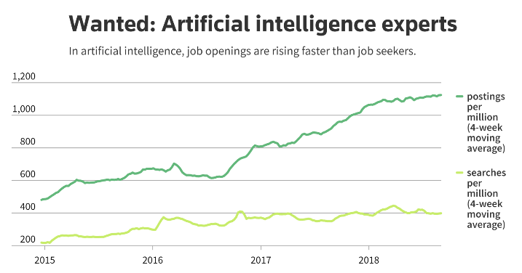
AI Demand – Supply Gap

Slide 17
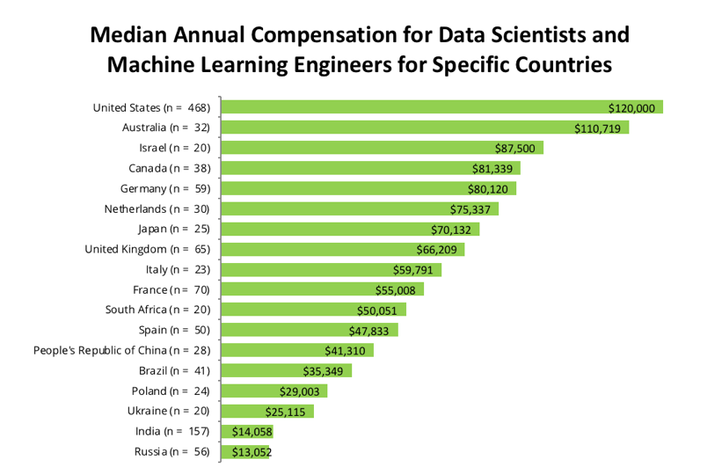
Average Salary Packages in AI

Slide 18
Roles / Profiles / Designation
AI Researcher
Client / CXO Interface
Product Owner
SME Coordination
Lead Data Scientist
Proof of Concept (PoC)
AI Developer
Execution of PoC
Scaling up
Development, Delivery & QA
AI DBA
Hadoop Stack Administration (Ambari)
Data Scientist

Slide 19
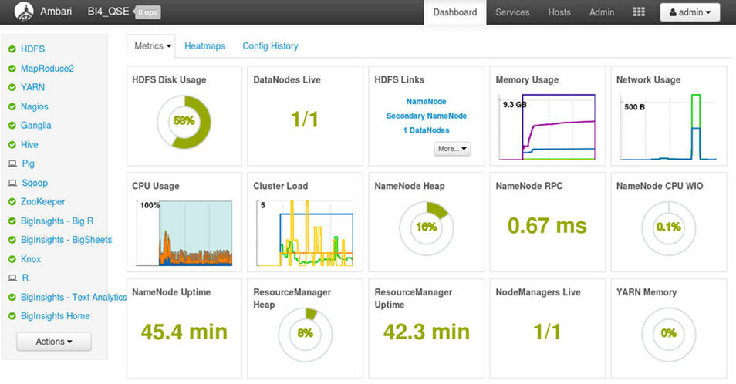
Ambari Dashboard

Slide 20
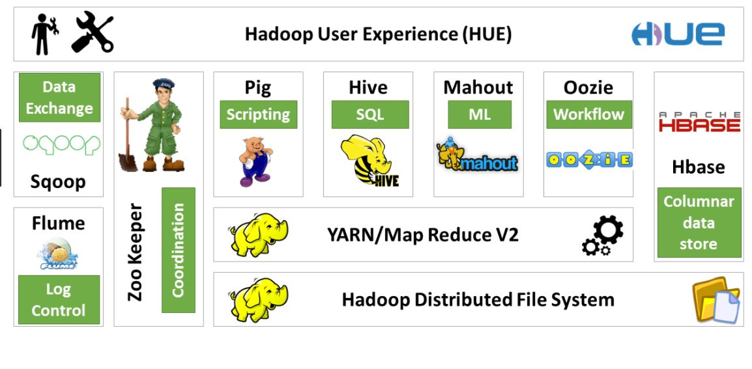
Hadoop Ecosystem

Slide 21




Hadoop Stack Environment

Slide 22

Why AI? Let us Intuit.
Would you cross this bridge?

Slide 23


Why AI? Let us Intuit.
Name the fruit.
Name the fruit.

Slide 24






Why AI? Let us Intuit.
Read this.

Slide 25


Why do we need ML / AI?
The world works on hard codes.
Tons of rules are already there.
RegEx can help.
We can define everything.
Why not make it easy?
Example:
How do you make a program that can identify between –
How many codes will you write?
How many possibilities can you think of?
What happens if we want to identify a banana now?

Slide 26

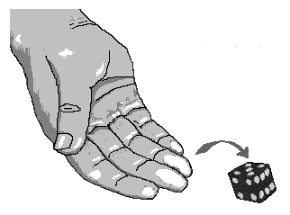
Why do we need ML / AI?
Let’s make a guess!
How many possible outcomes?

Slide 27
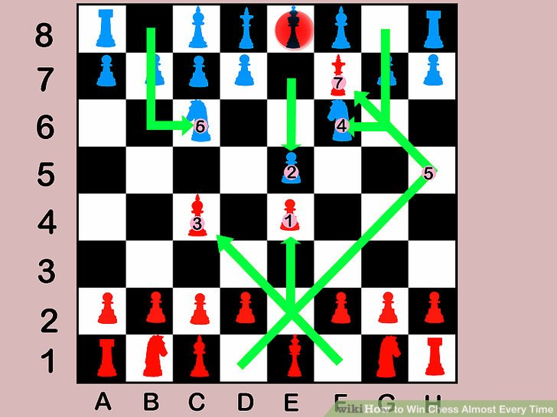
Why do we need ML / AI?
How about now?
There are 400 positions after 1 move.
There are 72,084 positions after 2 moves.
There are 9+ million positions after 3 moves!

Slide 28
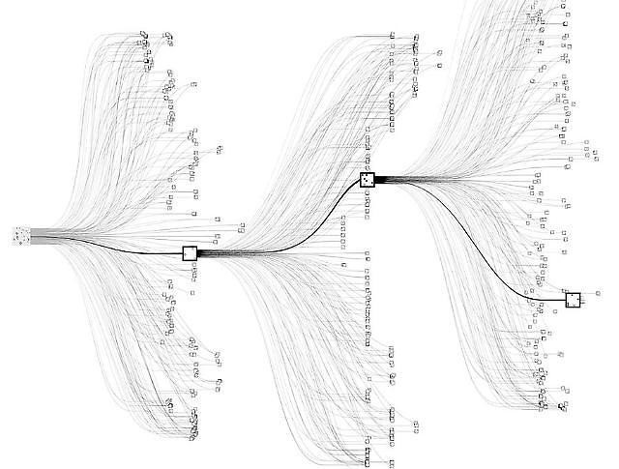
Why do we need ML / AI?
Go – an ancient Chinese board game –
the Trinity of strategic thoughtfulness.
There are more possible moves in Go,
than there are atoms in the universe.

Slide 29
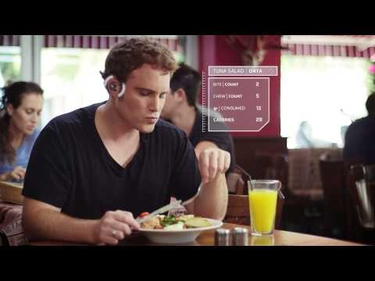
Examples of AI Systems - BitBite
https://www.youtube.com/watch?v=qU2w_qiP4Ck

Slide 30
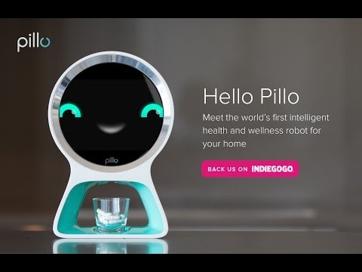
Examples of AI Systems - Pillo
https://www.youtube.com/watch?v=LjzQd6fTCXc

Slide 31
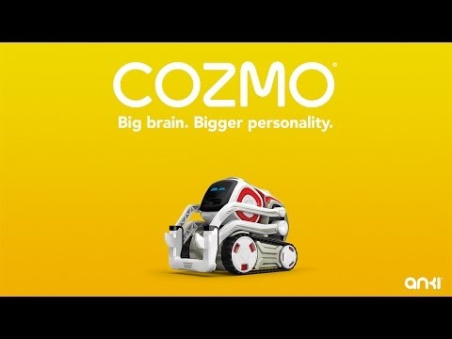
Examples of AI Systems - Cozmo
https://www.youtube.com/watch?v=cjFA531qJNE

Slide 32
AI – where the world stands today
Self Driving Car … https://www.youtube.com/watch?v=aaOB-ErYq6Y
Relaunchable Rockets … https://www.youtube.com/watch?v=1sJlFzUQVmY
Hyperloop - https://www.youtube.com/watch?v=u5V_VzRrSBI
Self Balancing Bike Honda … https://www.youtube.com/watch?v=VH60-R8MOKo
AI Car … https://www.youtube.com/watch?v=lItIyxGZUZQ
Facebook … https://www.youtube.com/watch?v=-CRJLam3BNc
Amazon Key … https://www.youtube.com/watch?v=wn7DBdaUNLA

Slide 33
Fundamental Logic behind AI
Very similar to a child’s learning process
Example – how does a child learns to speak?
Step 1 : Listens to a plethora of words (from parents) … Speech Recognition
Step 2: Associates meanings to words (trial and error) … NLP
Step 3: Associates output to a word / combination of words … Pattern Recognition (example – mum means water)
Step 4: Repeats the uttering of words to confirm output (every time mum is uttered, water is provided)
Step 5: Starts to form sentences
Step 6: Keeps learning new words
Step 7: Builds further on the gained information (example – learning physics in school)

Slide 34
Fundamental Logic behind AI
So the key is –
Learn by experimentation
Identify patterns
Remember occurrences
Transfer the learning to another process
Repeat
The ultimate aim being – get as close to perfection as possible.
In the end, any AI project is nothing but –
Multiple APIs working together, continuously. Difference – They learn.

Slide 35
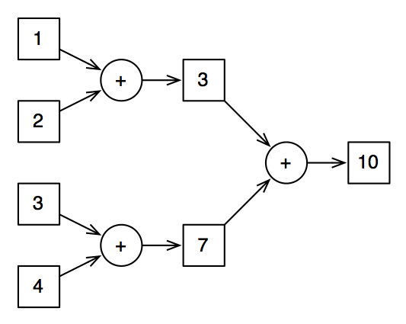
Simple Example of AI Training

Slide 36
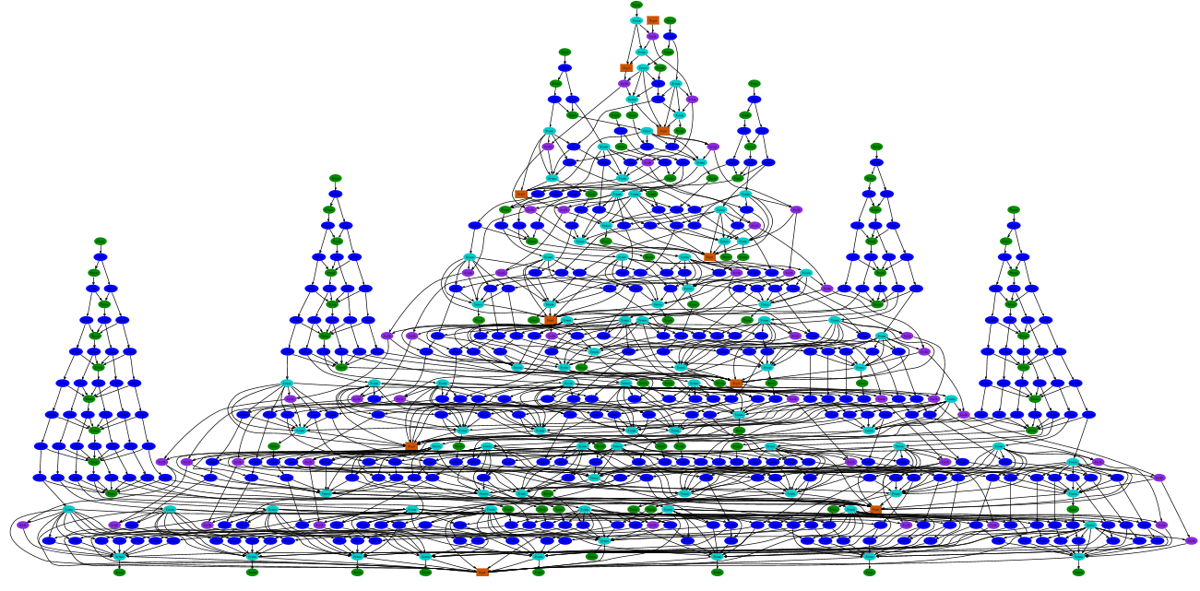
Getting inside the AI Brain

Slide 37
Key ingredients of AI
Useful Data … tons of it!
Correct Format
Correct set of instructions
Hardware capability
Data Scientists (Coaches)

Slide 38
Steps of any AI Project
Train
Test
Optimize
Deploy
Reiterate

Slide 39
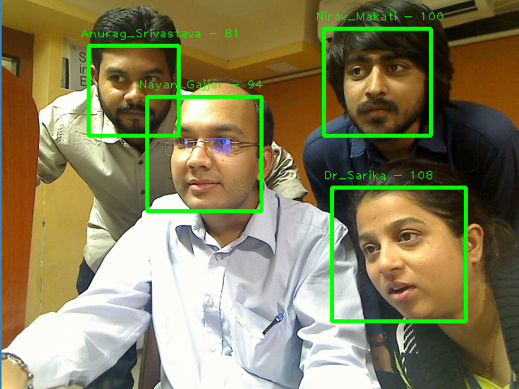
AI in Application

Slide 40
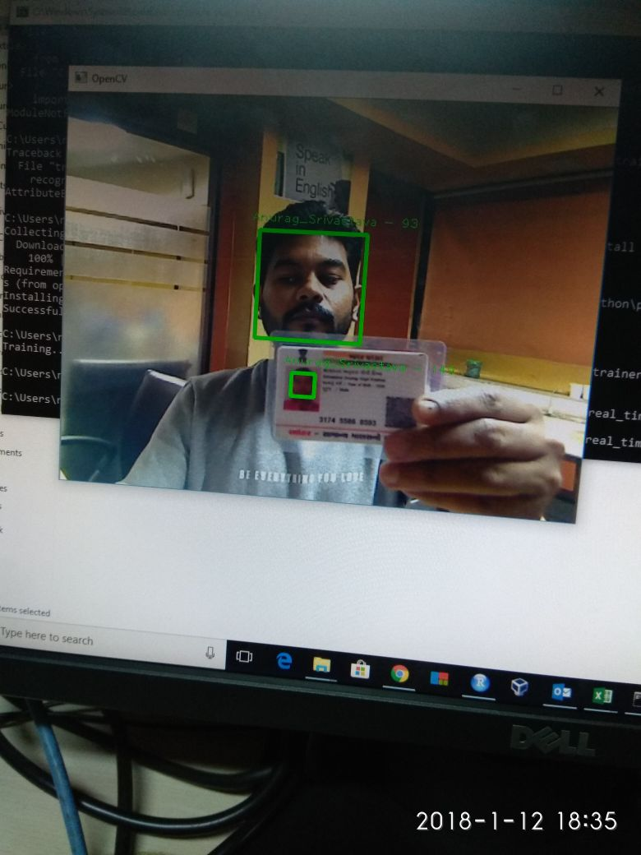
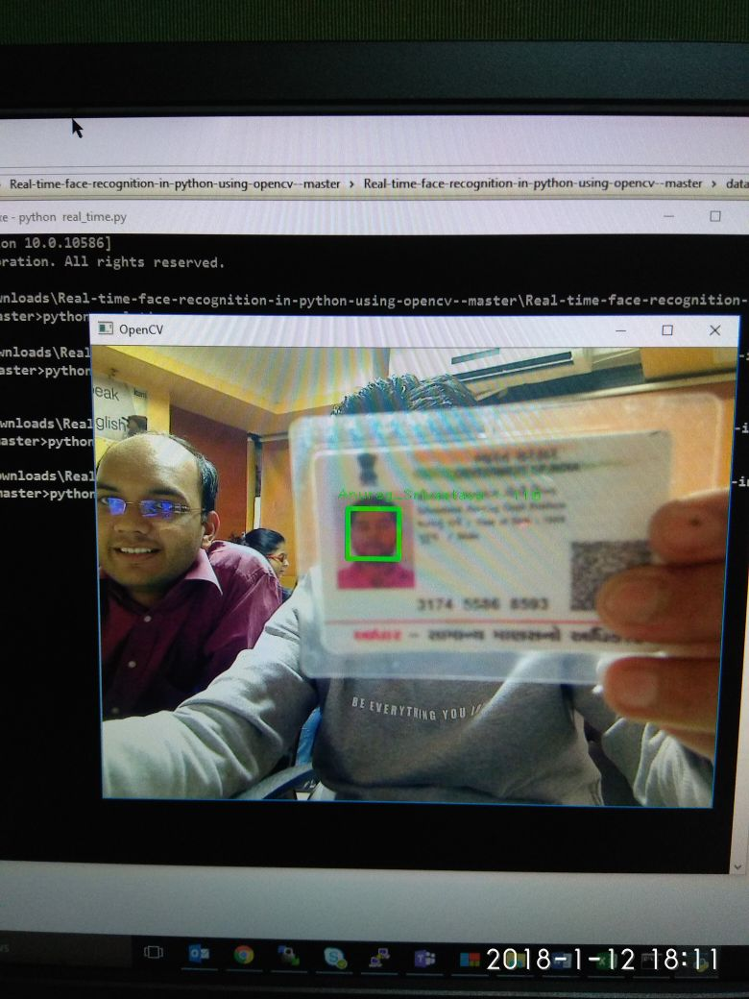
AI in Application

Slide 41
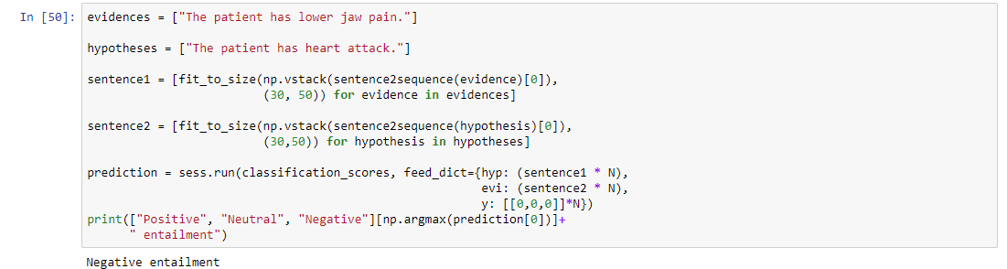
AI in Application

Slide 42
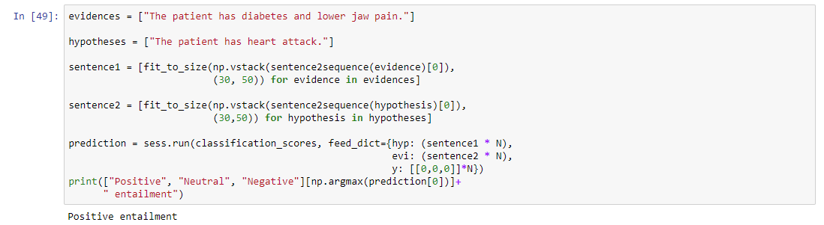
AI in Application

Slide 43
AI in Application
Reading Handwritten Digits

Slide 44
AI in Application
Building a chatbot

Slide 45
AI in Application
Recognizing Images

Slide 46
AI in Application
Teaching to master a game

Slide 47
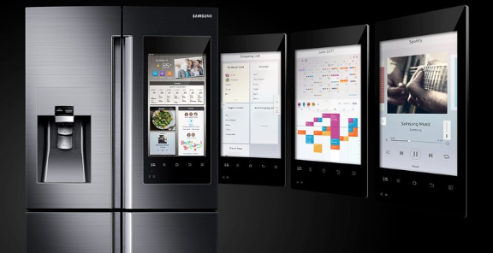
AI Use Case – e Commerce
Build website in minutes.
Online grocery app – powered by AI.

Slide 48
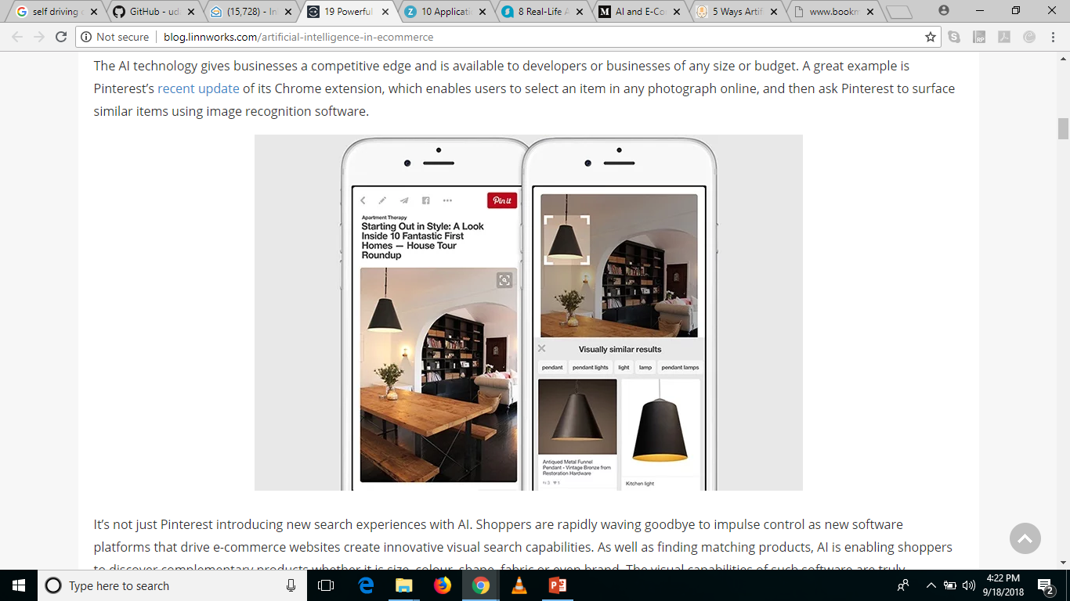
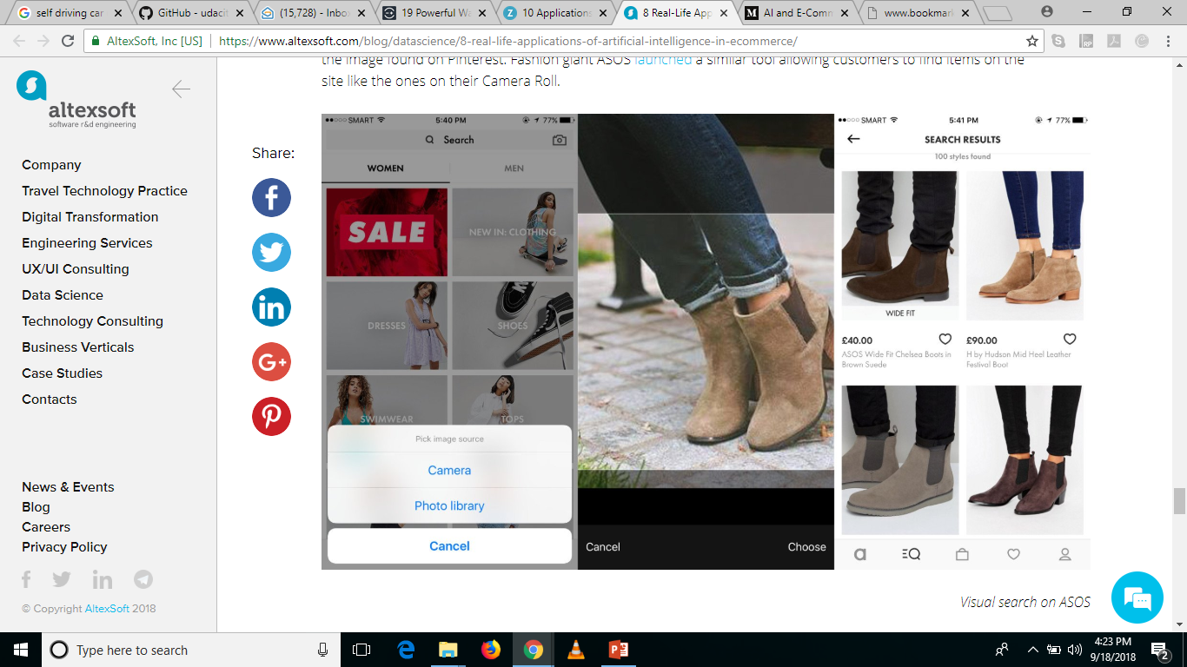
AI Use Case – e Commerce
App that suggests recipes using the inventory of your fridge – Chefling
Custom Search – Pinterest.

Slide 49
AI Use Case – e Commerce
Identify exceptional target prospects
Mintigo’s software, Getty images has successfully generated significant new leads by capturing the data that shows which businesses have websites featuring images from Getty's competitors.

Slide 50
AI Use Case – e Commerce
Chatbots
Virtual Assistants
By using Alexa on Amazon’s Echo device, customers can discover local gigs for the upcoming weekend through StubHub, arrange transport to and from the event via Uber, or even order pre-event dinner from Domino’s (and track the order status in real time).
Wish
On the spot personal pricing
Tackle fake reviews
www.fakespot.com
Inventory Management & Sales Forecasting
Generating product descriptions in any writing style

Slide 51
AI Use Case – Software Development
Better QA with.
Defense Advanced Research Projects Agency (DARPA) held a major event to develop systems that can automatically and autonomously "detect, evaluate and patch software vulnerabilities" to improve cybersecurity.
Integrate AI components to build a better software.
AI builds software on its own is in progress.
Games are being generated via AI.
Mario + Contra + Age of Empires
Intelligent Programming Assistants ( Kite for Python and Codota for Java)
Just-in-time support and recommendations, such as relevant document, best practices, and code examples.

Slide 52
AI Use Case – Software Development
Automated Error Handling
Programming assistants can also learn from past experience to identify common errors and flag them automatically during the development phase.
Precise Estimation
Machine learning can train on data from past projects - such as user stories, feature definitions, estimates, and actuals - to predict effort and budget more accurately.

Slide 53
AI Use Case – Financial Services
Driving styles and penalty points can lead to higher premiums.
Wallet – Personal Financial Management
Analyzes your entire web footprint and creates a spending graph
Accordingly suggests investments
Medically fit customers will pay lower premiums those who share their data with providers. (Fit – lower risk of future diseases)
This will change month over month
Fraud Detection, Credit Scoring and Classification of customers (defaulter vs non defaulter).
Parsing Financial Deals (J.P. Morgan Lawyers) takes few minutes today. JP Morgan has harnessed the power of this application of AI - COiN, leading to freeing 360,000 hours (yearly) from its employees’ load in only a few seconds.

Slide 54
Imagine Real Time Modules
Deception detection in speech
Image verification – KYC – document photo and selfie
Reading handwritten forms / applications (any language)
Intuitive client risk profiling (social media data + financial data)
Voice based initial screening of loan applicants - https://www.youtube.com/watch?v=oUf9_rS1fYg
Transactional bots - digital assistants helping users navigate their finance plans, savings, and spending based on web footprints.
OCR can be used to digitize hard copy documents. An NLP model with layered business logic can then interpret, record, and correct contracts at high speed.

Slide 55
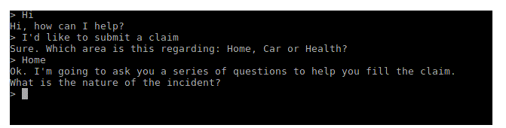
Transactional Bots
Automated Claims Processes –
Walks the customer through the process, step by step, in a conversational format.
It asks for videos or photos of the damage and uploads them to the database. It takes in all the information required for the processing of the claim. The bot can then run the application through a fraud detection method, looking for anomalies and non-compliant data.
It then moves on to the adjustment model where it provides a range of values for payout. Once all data is set, human intervention can be included for auditing purposes. The bot can at this point calculate and propose payout amounts, based on a payout predictor model it has been trained on.

Slide 56
Transactional Bots
AI assistance with claims settlement is fast and more successful.
And fast means — 3 seconds from claim submission to payment. This is the result of the independent work of Lemonade’s AI - Jim.
Lemonade is a New York based Insurance startup.
What AI can do is to assist, advise, and create a better customer experience. At the moment, AI complements human work and makes it more efficient, but it isn’t aimed to replace a human.

Slide 57
M.E.L.I.S.A.
Understanding EHR, RCM and Inventory Management from Healthcare Perspective.
Applying AI.

Slide 58
M.E.L.I.S.A.
Applying AI.

Slide 59
ML Algorithms
Simple Linear Regression
Multiple Regression
Logistic Regression
Decision Trees
Random Forests
XGBoost
Naïve Bayes
Support Vector Machines (SVM)
Clustering (k-means and hierarchical)
Apriori
Conjoint Analysis for Customer Choice Modeling

Slide 60

AI Algorithms
Neural Networks

Slide 61
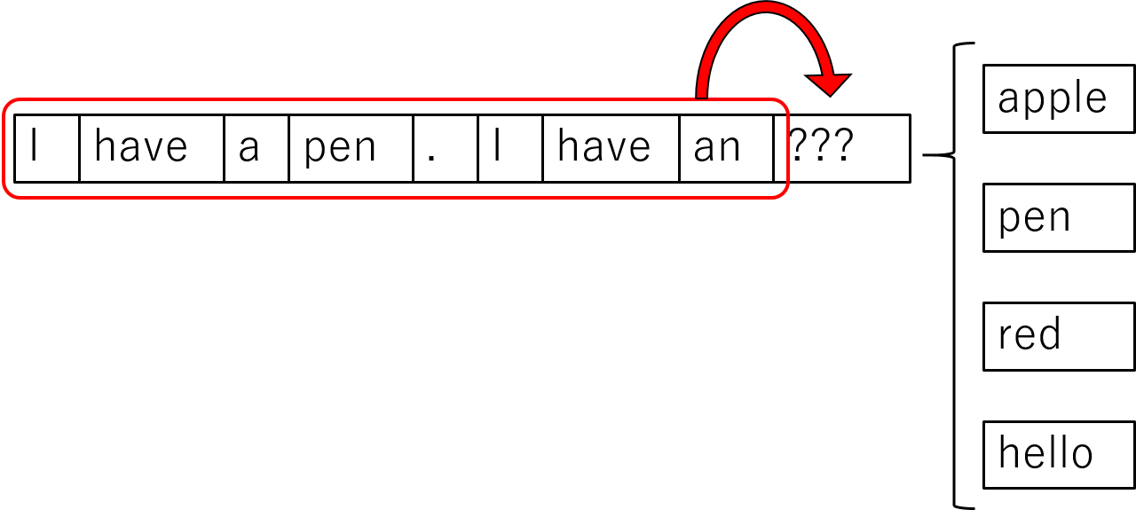
AI Algorithms
Neural Networks
RNNs & LSTMs

Slide 62

AI Algorithms
Neural Networks
CNNs

Slide 63

AI Algorithms
Neural Networks
Autoencoders & RBMs

Slide 64
AI Libraries
TensorFlow
Keras
TFLearn
Theano

Slide 65
AI Tools
Python (Only for AI)
R (Only for ML)

Slide 66
Other Applications
Limited by your imagination – think out of the box!
Whatever a human can do, AI WILL do it for you.
Make it read a book, extract summaries, make precis, identify relevant information, create videos, create models, create text to images, write a story around an image, NLP, Speech Recognition and upgrades to Jarvis (Iron Man), read your handwriting (Scribbling apps), correcting grammar in sentences, self driving car, create applications, create music, movie scripts, etc.
https://github.com/udacity/self-driving-car-sim
Suggested Movies for AI ideas and applications –
The Imitation Game
Eagle Eye

Slide 67
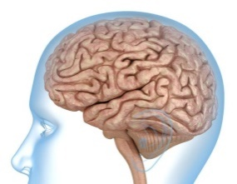

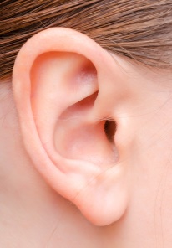

To conclude, What is AI?
Machine Learning
(Pattern Recognition)
Image Recognition /
Computer Vision
AI
Speech Recognition
Natural Language
Processing (NLP) /
Speech Engines

Slide 68
Questions?
Thank you.

